Slide 1
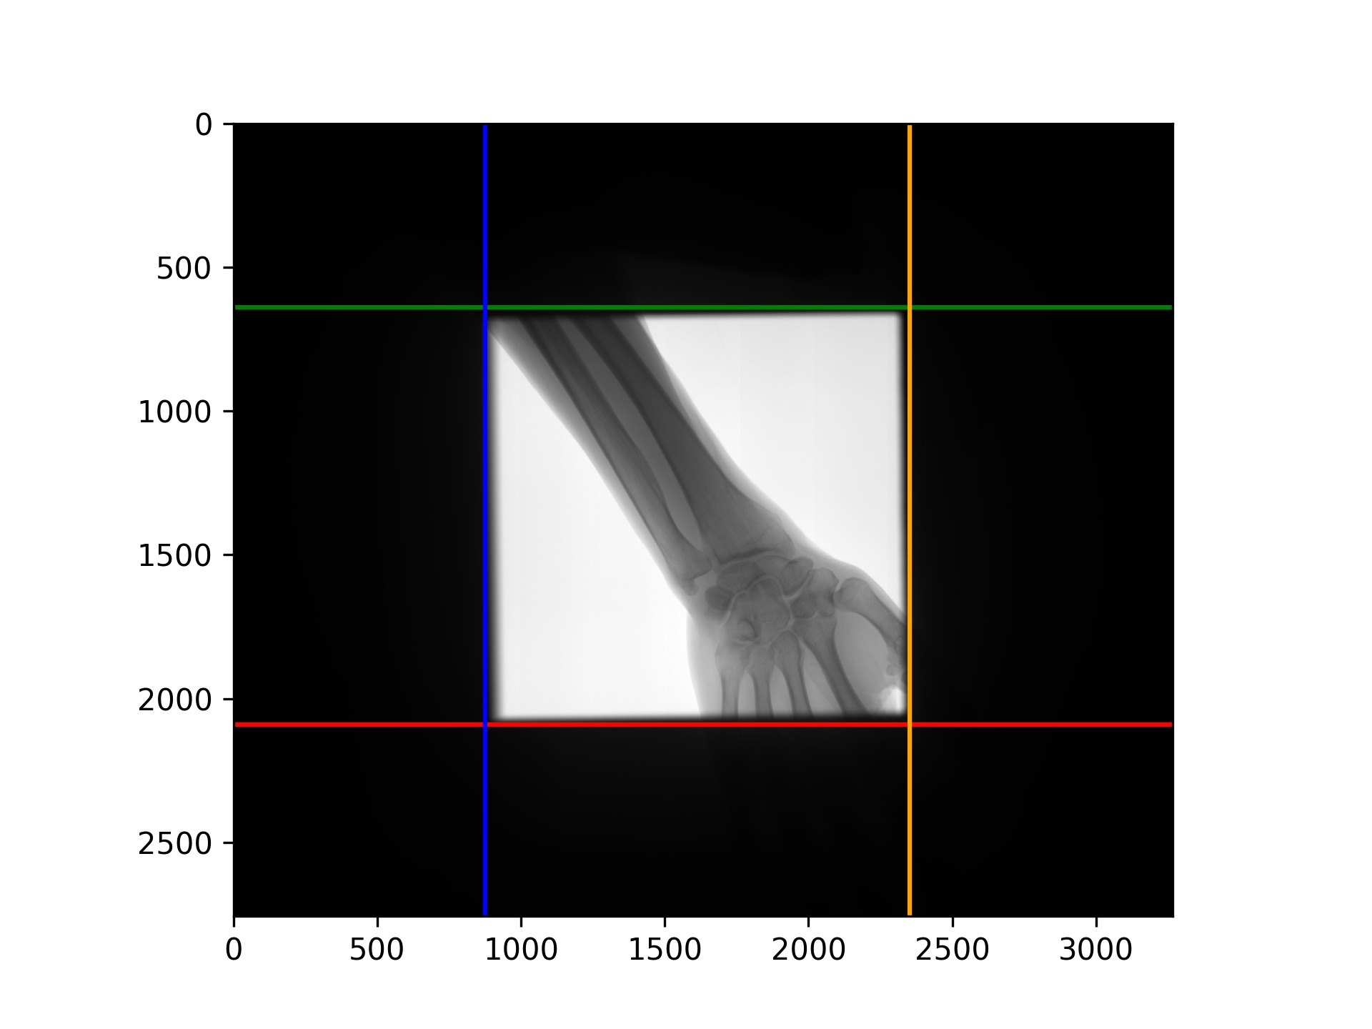
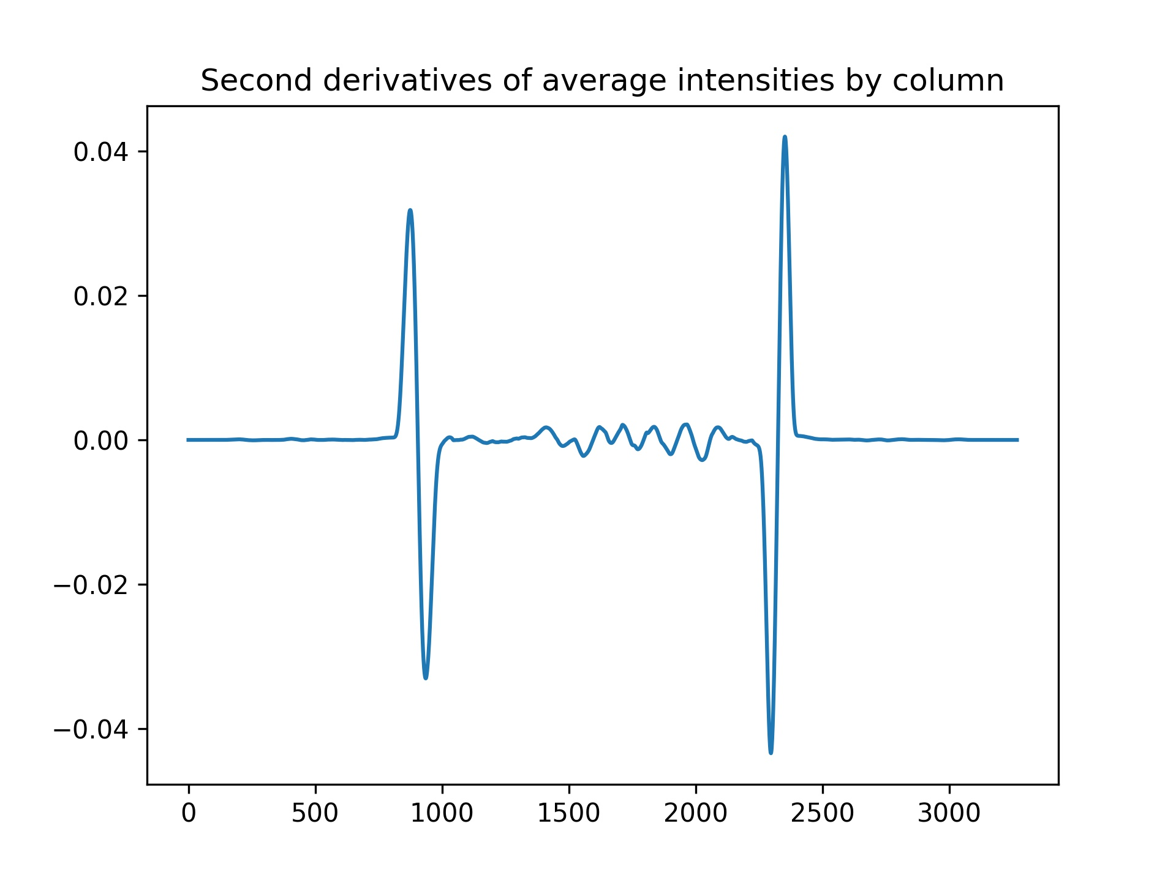
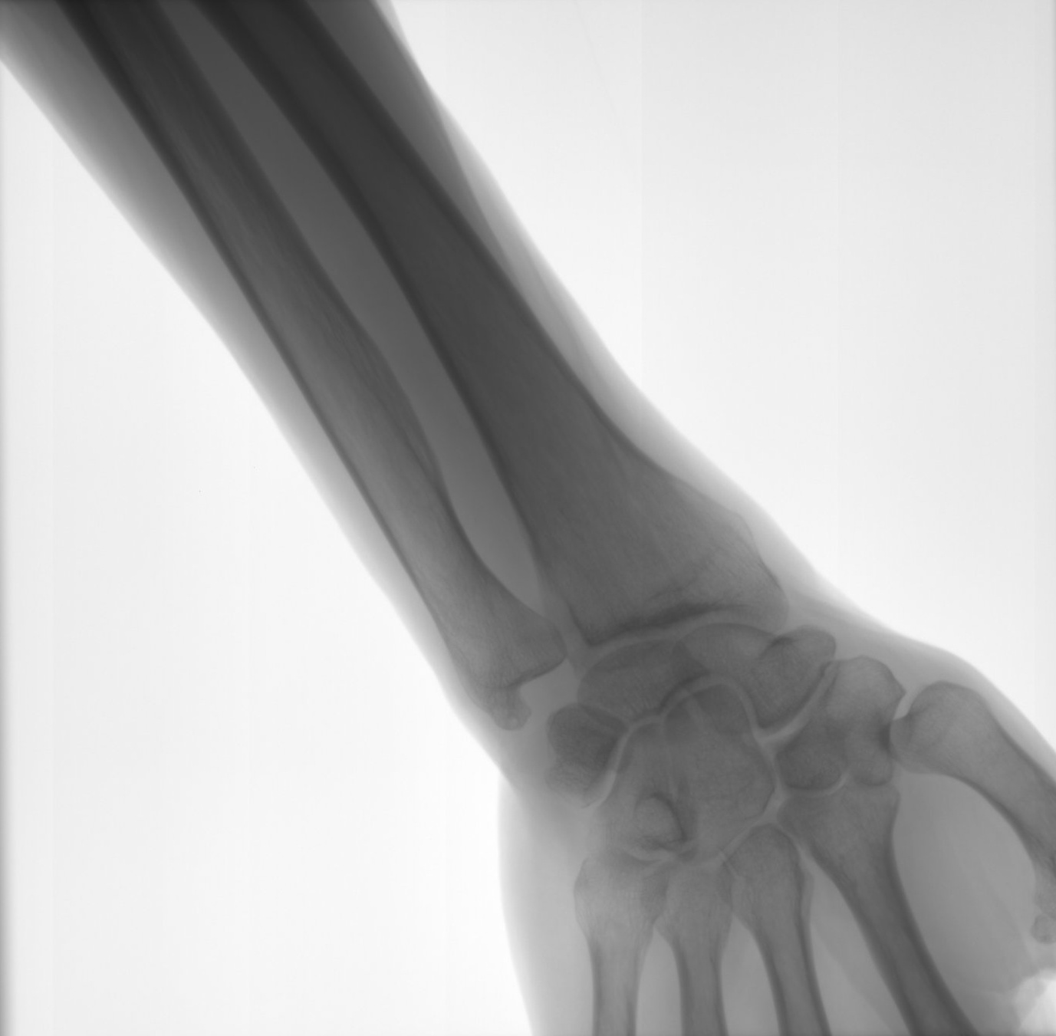
Collimator Detection
Average over intensities of horizontal and vertical pixels
Find second derivative peaks
Plot lines on edges

